Slide 1
DATABASE IMPLEMENTATION · APPLICATION DEVELOPMENT
Faculty Workload
and Timetable
Management System
Combined Review 2 + Review 3
Student: To be verified
Roll number: To be verified
Programme, guide, university, academic year: To be verified
Notes:
Introduce the project as a combined review of the database implementation and the application development. State clearly that student and institutional details remain to be verified.

Slide 2
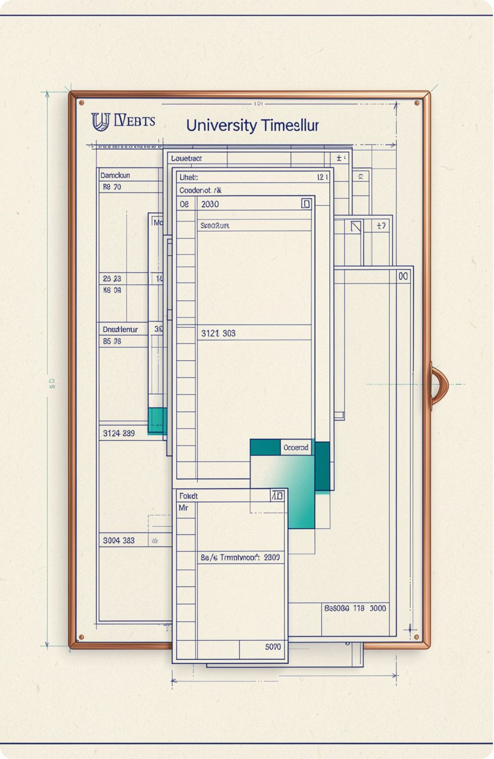




THE PROBLEM
Manual scheduling creates avoidable coordination work
Centralize
Track
Faculty, courses, rooms, sections, and assignments.
Teaching workload against defined limits.
Schedule
Flag
Classes through rooms and time slots.
Substitutions, faculty conflicts, and room conflicts.
Notes:
Frame the project around coordination work. The system is intended to centralize the facts, monitor workload, schedule classes, and surface conflicts or substitutions before they become operational problems.

Slide 3

APPLICATION ARCHITECTURE
Flask connects the interface to SQLite
User → Web Interface → Flask Application → SQL Database Operations → SQLite Relational Database. Updated data returns to the interface.
Web Interface
Flask App
SQL Operations
SQLite DB
Architecture diagram · implementation details to be verified against the supplied application.
Notes:
Walk down the architecture from the user to the database and back. Emphasize Flask as the request-processing layer and SQLite as the relational store. The exact implementation should be confirmed against the project files.

Slide 4
RELATIONAL DESIGN
The relational design links scheduling facts through verified keys
REFERENCE ENTITIES
OPERATIONAL ENTITIES
Departments · Programmes · Courses · Sections · Faculty · Workload norms · Rooms · Time slots
Assignments · Timetable entries · Substitutions
Relationship focus: faculty–course assignments; timetable links to rooms and time slots.
Schema check: verify primary keys, foreign keys, and referential integrity against the actual schema.
Proposed design — complete ER diagram, columns, and cardinalities: To be verified.
Notes:
Explain the model in two layers. Reference entities describe the available academic and physical resources. Operational entities record how those resources are used. Do not present column names or cardinalities as final until the actual schema is verified.

Slide 5
NORMALIZATION
Normalization separates facts that change for different reasons
1NF
ILLUSTRATIVE EXAMPLE
Assignment facts
Atomic values and no repeating groups.
Faculty, course, section, and workload details should not be repeated in every timetable record.
2NF
Remove partial dependencies on composite candidate keys.
EVIDENCE STATUS
Illustrative — verify the example and its functional dependencies against the implemented schema.
3NF
Remove transitive dependencies among non-key attributes.
Notes:
Use the three normal forms as a review checklist. The assignment example is intentionally illustrative. Confirm the actual candidate keys and dependencies before claiming that a particular decomposition is implemented.

Slide 6



DATA INTEGRITY
Constraints make invalid states harder to store
ILLUSTRATIVE SQL
CONSTRAINTS TO VERIFY
CREATE TABLE faculty (
faculty_id INTEGER PRIMARY KEY,
name TEXT NOT NULL
);
PRIMARY KEY
FOREIGN KEY
NOT NULL
UNIQUE
INSERT
SELECT
UPDATE
INSERT INTO faculty ...;
SELECT ... FROM faculty;
UPDATE faculty ...;
SQL snippets are illustrative until implementation files are supplied and tested.
Notes:
Explain that constraints support consistency across related records. The SQL shown is a compact teaching example, not verified implementation evidence. The actual table definitions and statements should be checked against the project files.

Slide 7
REPORTING QUERIES
Queries turn relational data into workload and timetable reports
Illustrative only: verify table and column names against the supplied schema, and test every query.
JOIN
GROUP BY · HAVING
TIMETABLE
Faculty and course context
Workload review
Scheduled classes
GROUP BY to calculate teaching workload; HAVING to identify workload above a threshold.
List scheduled classes by day and time; detect potential conflicts.
JOIN faculty with assignments; JOIN courses with assignments.
Notes:
Connect each SQL operation to a practical report. Joins provide context, grouping calculates workload, HAVING isolates cases for review, and ordered timetable queries make scheduling conflicts visible.

Slide 8
APPLICATION WORKFLOW
The application turns assignments into validated timetable entries
Dashboard and faculty overview show information stored in SQLite. The workflow links stored academic records to a timetable entry only after the required information is present.
Workflow
Screenshot placeholders
Register faculty and courses
Link faculty to courses and sections
Assign weekly hours, room, and time slot
Save after validation
PLACEHOLDER
PLACEHOLDER
Faculty view
Course view
PLACEHOLDER
PLACEHOLDER
Assignment view
Timetable view
Actual application screenshots to be supplied.
Screenshot evidence: To be verified. The workflow does not imply automatic course assignment.
Notes:
Describe the intended workflow without claiming that the prototype performs more than the evidence shows. Make the distinction between linking an assignment and automatically assigning a course explicit.

Slide 9
TESTING EVIDENCE
Conflict detection is a key validation point
Test case | Input or action | Expected result / Actual result
Add faculty member | To be verified | Faculty record is created · To be verified
Register course | To be verified | Course record is created · To be verified
Create assignment | To be verified | Faculty-course link is stored · To be verified
Schedule class | To be verified | Entry is saved after validation · To be verified
Attempt room conflict | To be verified | Conflict is identified · To be verified
Attempt faculty conflict | To be verified | Conflict is identified · To be verified
Check workload | To be verified | Workload is displayed · To be verified
Notes:
Use the matrix to separate expected behavior from observed behavior. The two conflict cases are the key validation point, but record creation and workload display also need evidence.

Slide 10
CLOSING REVIEW
The prototype demonstrates a grounded path to better scheduling
Implemented scope: summarize from supplied application evidence.
Limitations: To be verified from the actual project files and screenshots.
Future scope: automated timetable generation, optimization, role-based authentication, export, substitution notifications, and richer analytics.
Thank You — Questions?
Notes:
Close by distinguishing the grounded prototype scope from future scope. Name the evidence still required before making implementation claims, then invite questions.

